Slide 1
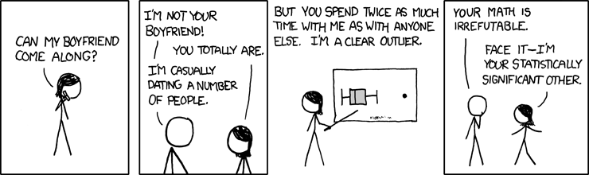
Conformal Inference

Slide 2
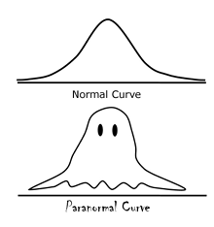
Introduction
Introduced for the first time be Gammerman et al. [1]. They focused on creating prediction sets for a binary response
Saunders et al. [2] used p-values to create prediction sets. This is the current framework in use
Wasserman et al. [3] brought conformal prediction from CS to Stats. A nice overview is given by Angelopoulos and Bates [4].

Slide 3
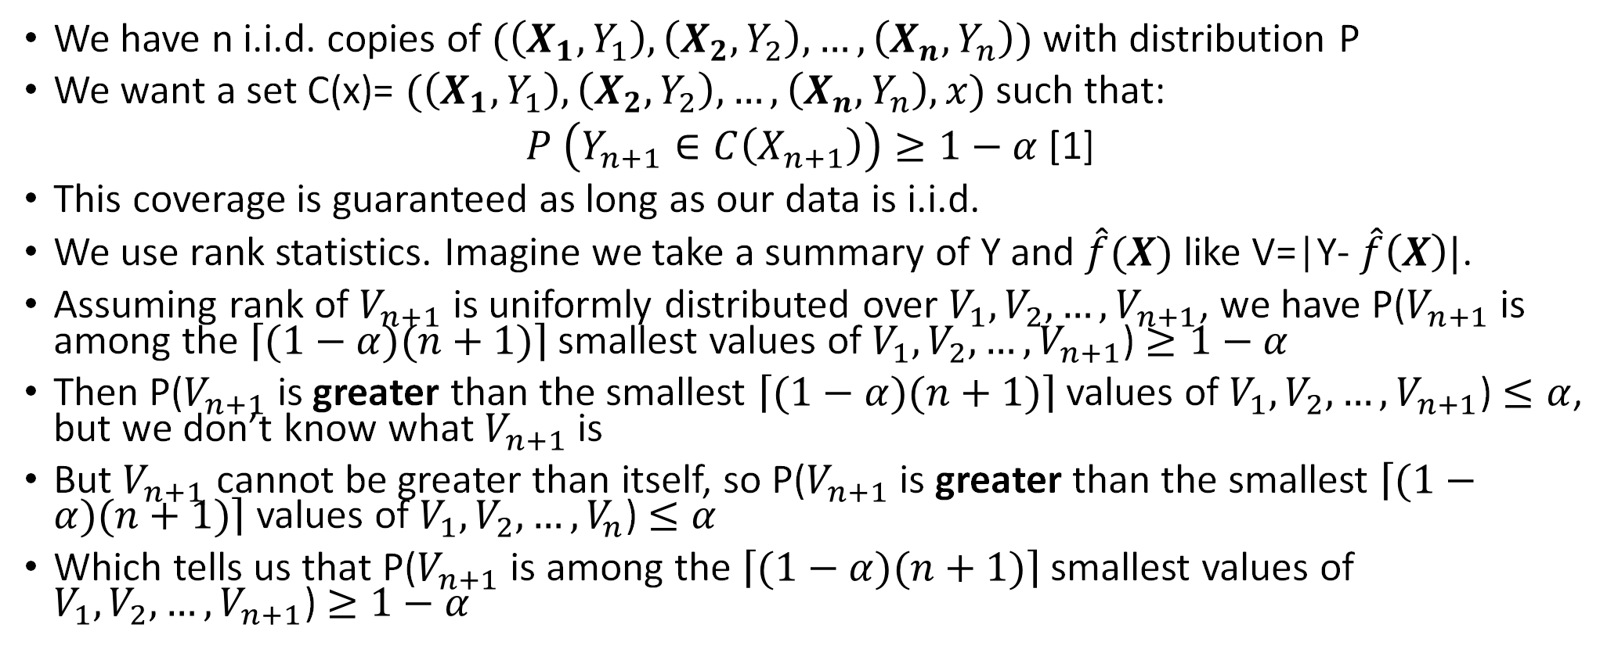
Setup
We have n i.i.d. copies of $(\left(X_{1},Y_{1}\right),\left(X_{2},Y_{2}\right), …, \left(X_{n},Y_{n}\right))$ with distribution P
We want a set C(x)= $(\left(X_{1},Y_{1}\right),\left(X_{2},Y_{2}\right), …, \left(X_{n},Y_{n}\right),x)$ such that:
$P \left(Y_{n+1}∈C\left(X_{n+1}\right)\right)≥1−α$ [1]
This coverage is guaranteed as long as our data is i.i.d.
We use rank statistics. Imagine we take a summary of Y and $\hat{f}(X)$ like V=|Y- $\hat{f}\left(X\right)|$.
Assuming rank of $V_{n+1}$ is uniformly distributed over $V_{1},V_{2},…,V_{n+1}$, we have P($V_{n+1}$ is among the $\left\lceil (1−α)(n+1)\right\rceil$ smallest values of $V_{1},V_{2},…,V_{n+1}$) $≥1−α$
Then P($V_{n+1}$ is greater than the smallest $\left\lceil (1−α)(n+1)\right\rceil$ values of $V_{1},V_{2},…,V_{n+1}$) $≤α$, but we don’t know what $V_{n+1}$ is
But $V_{n+1}$ cannot be greater than itself, so P($V_{n+1}$ is greater than the smallest $\left\lceil (1−α)(n+1)\right\rceil$ values of $V_{1},V_{2},…,V_{n}$) $≤α$
Which tells us that P($V_{n+1}$ is among the $\left\lceil (1−α)(n+1)\right\rceil$ smallest values of $V_{1},V_{2},…,V_{n+1}$) $≥1−α$
Notes:
theproof ofTheorem5criticallyreliesonthefactthatthescoresYn+1 n+1 isexchangeablewithsYn+1 1 ,...,sYn+1 n .Wedefer theproofto[1],andnotethatupperboundin(1)alsoholdswhenthescorefunctioniscontinuous.

Slide 4
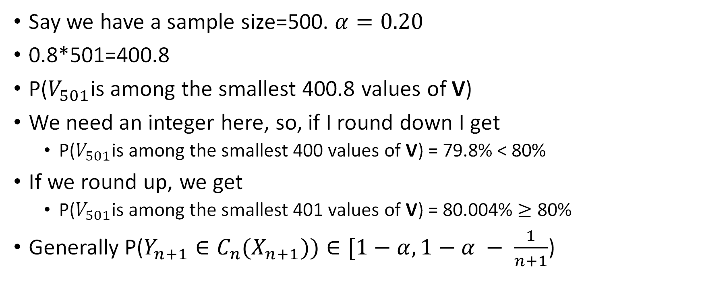
Why ceil?
Say we have a sample size=500. $α=0.20$
0.8*501=400.8
P($V_{501}$is among the smallest 400.8 values of V)
We need an integer here, so, if I round down I get
P($V_{501}$is among the smallest 400 values of V) = 79.8% < 80%
If we round up, we get
P($V_{501}$is among the smallest 401 values of V) = 80.004% $≥$ 80%
Generally P($Y_{n+1}∈C_{n}(X_{n+1}))∈[1−α,1−α − \frac{1}{n+1}$)

Slide 5
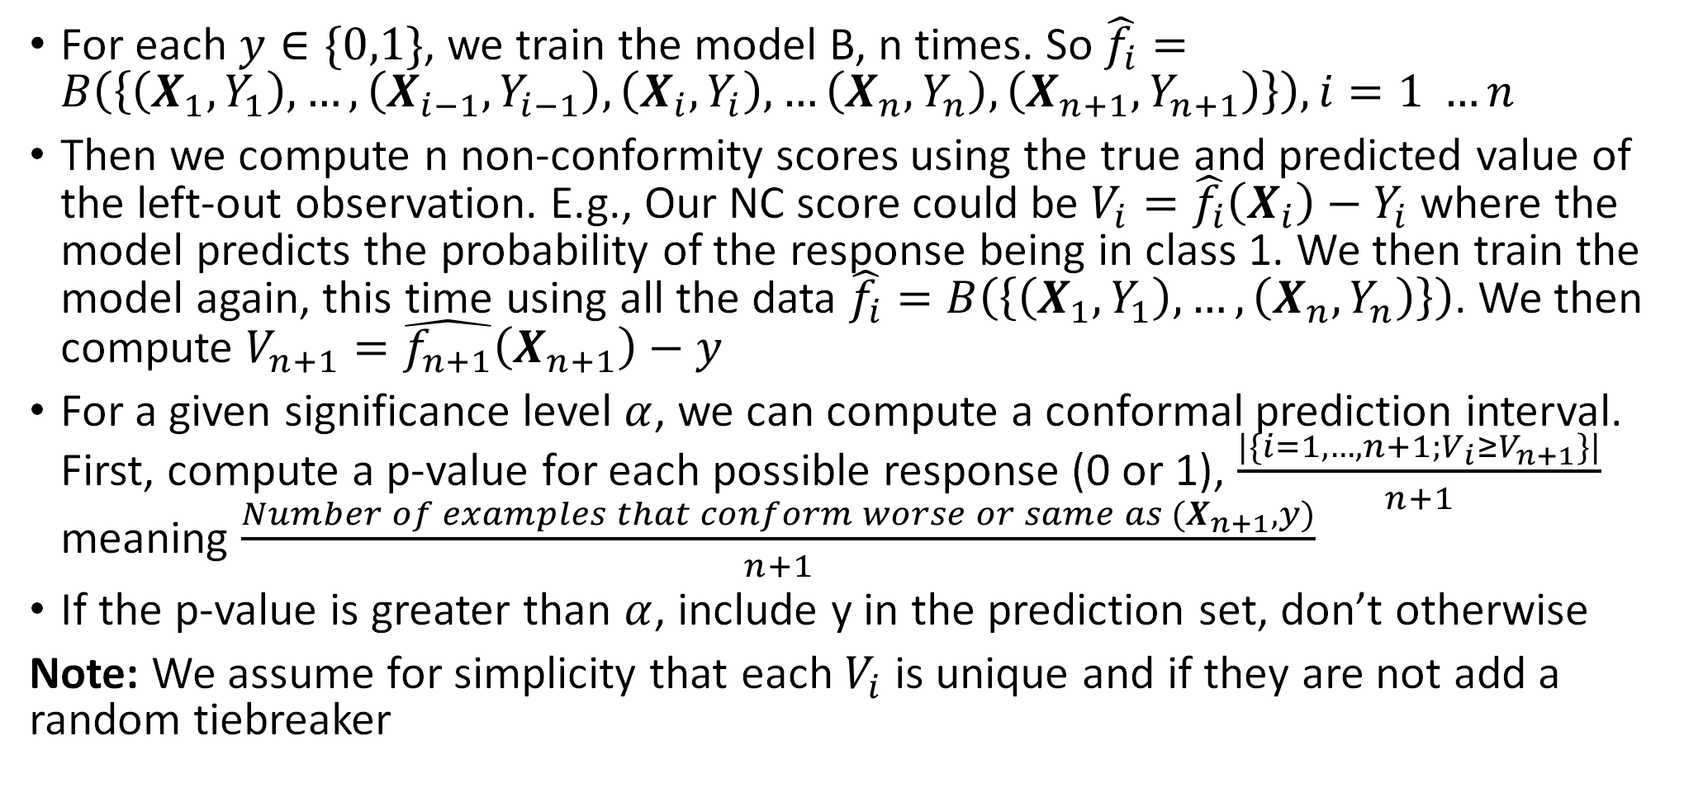
Full Conformal Prediction for a Discrete Response
For each $y∈\{0,1\}$, we train the model B, n times. So $\hat{f_{i}}=B\left(\left\{\left(X_{1},Y_{1}\right),…,\left(X_{i−1},Y_{i−1}\right),\left(X_{i},Y_{i}\right),…\left(X_{n},Y_{n}\right),\left(X_{n+1},Y_{n+1}\right)\right\}\right), i=1 …n$
Then we compute n non-conformity scores using the true and predicted value of the left-out observation. E.g., Our NC score could be $V_{i}=\hat{f_{i}}\left(X_{i}\right)−Y_{i}$ where the model predicts the probability of the response being in class 1. We then train the model again, this time using all the data $\hat{f_{i}}=B\left(\left\{\left(X_{1},Y_{1}\right),…,\left(X_{n},Y_{n}\right)\right\}\right)$. We then compute $V_{n+1}=\hat{f_{n+1}}\left(X_{n+1}\right)−y$
For a given significance level $α$, we can compute a conformal prediction interval. First, compute a p-value for each possible response (0 or 1), $\frac{|\{i=1,…, n+1;V_{i}≥V_{n+1}\}|}{n+1}$ meaning $\frac{Number of examples that conform worse or same as (X_{n+1}, y)}{n+1}$
If the p-value is greater than $α$, include y in the prediction set, don’t otherwise
Note: We assume for simplicity that each $V_{i}$ is unique and if they are not add a random tiebreaker

Slide 6
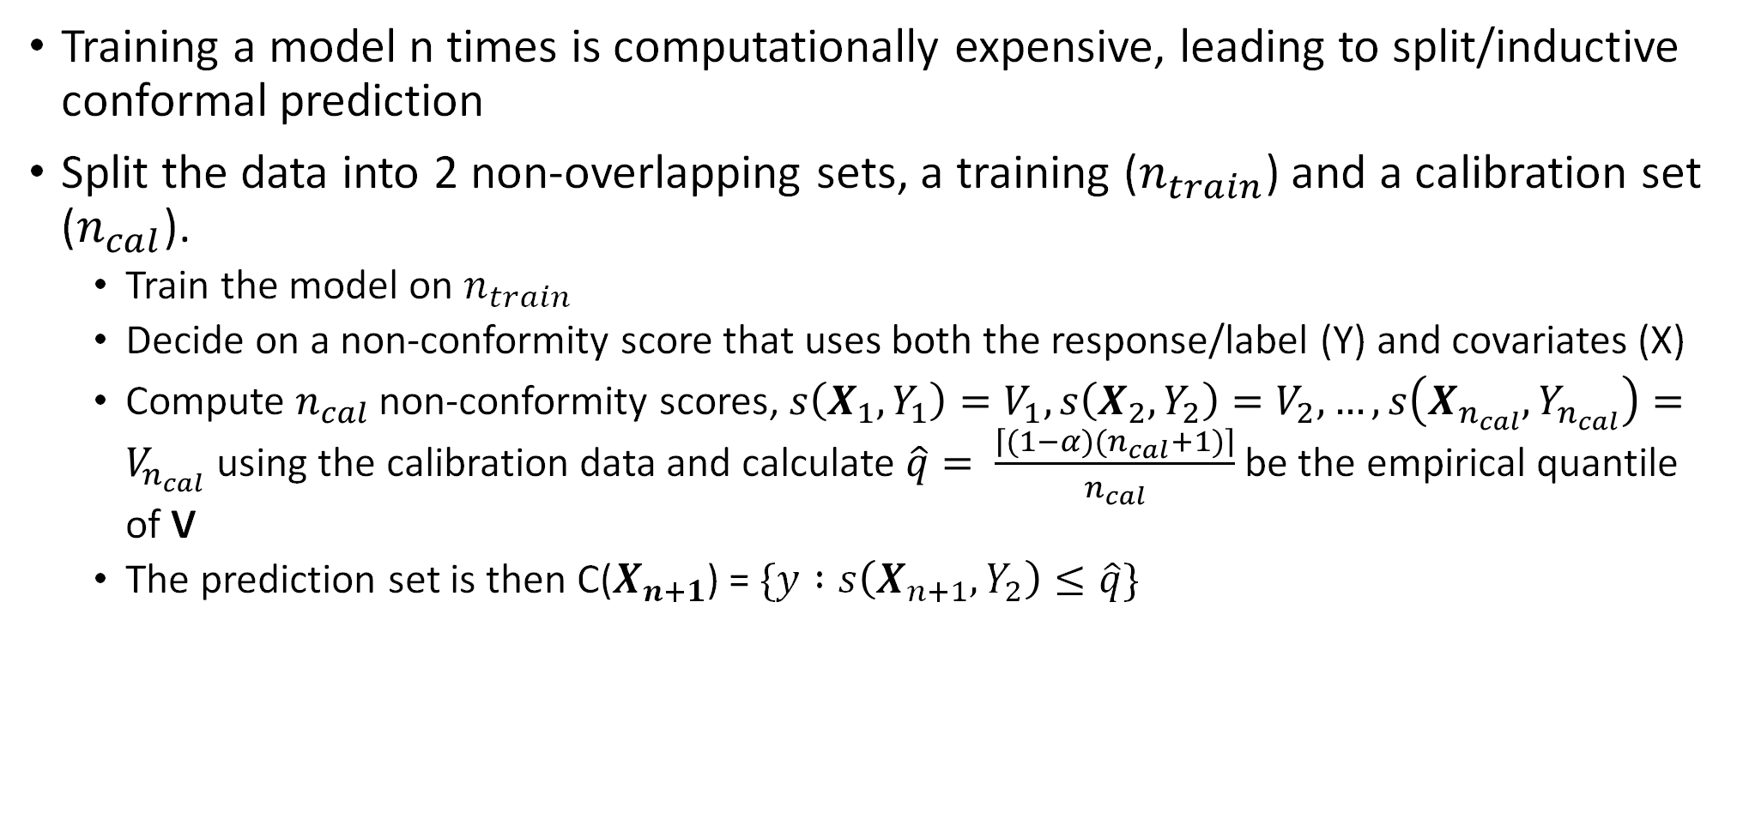
Split Conformal Prediction
Training a model n times is computationally expensive, leading to split/inductive conformal prediction
Split the data into 2 non-overlapping sets, a training ($n_{train}$) and a calibration set ($n_{cal}$).
Train the model on $n_{train}$
Decide on a non-conformity score that uses both the response/label (Y) and covariates (X)
Compute $n_{cal}$ non-conformity scores, $s\left(X_{1},Y_{1}\right)=V_{1},s\left(X_{2},Y_{2}\right)=V_{2}, …,s\left(X_{n_{cal}},Y_{n_{cal}}\right)=V_{n_{cal}}$ using the calibration data and calculate $\hat{q}= \frac{\left\lceil (1−α)(n_{cal}+1)\right\rceil }{n_{cal}}$ be the empirical quantile of V
The prediction set is then C($X_{n+1}$) = $\{y :s\left(X_{n+1},Y_{2}\right)≤\hat{q}\}$

Slide 7
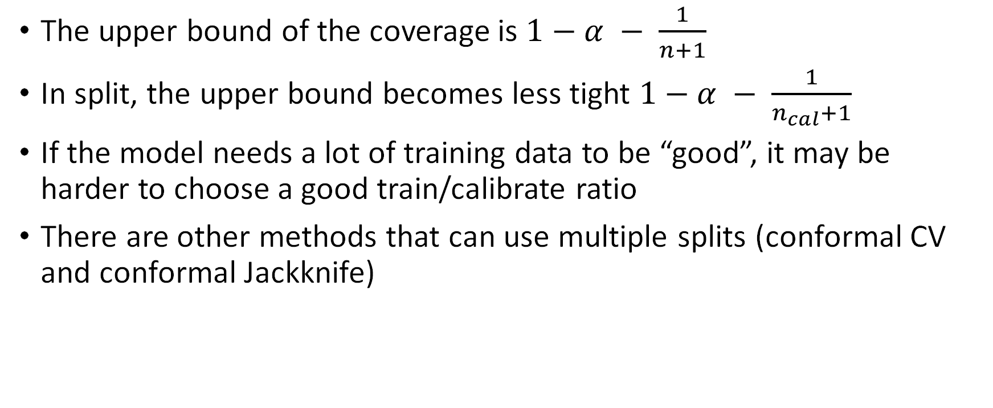
Insights from Split Conformal Prediction
The upper bound of the coverage is $1−α − \frac{1}{n+1}$
In split, the upper bound becomes less tight $1−α − \frac{1}{n_{cal}+1}$
If the model needs a lot of training data to be “good”, it may be harder to choose a good train/calibrate ratio
There are other methods that can use multiple splits (conformal CV and conformal Jackknife)

Slide 8
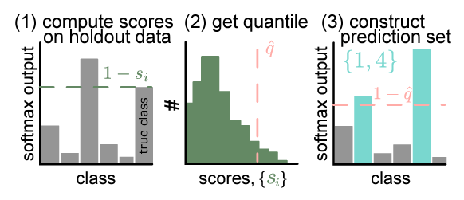
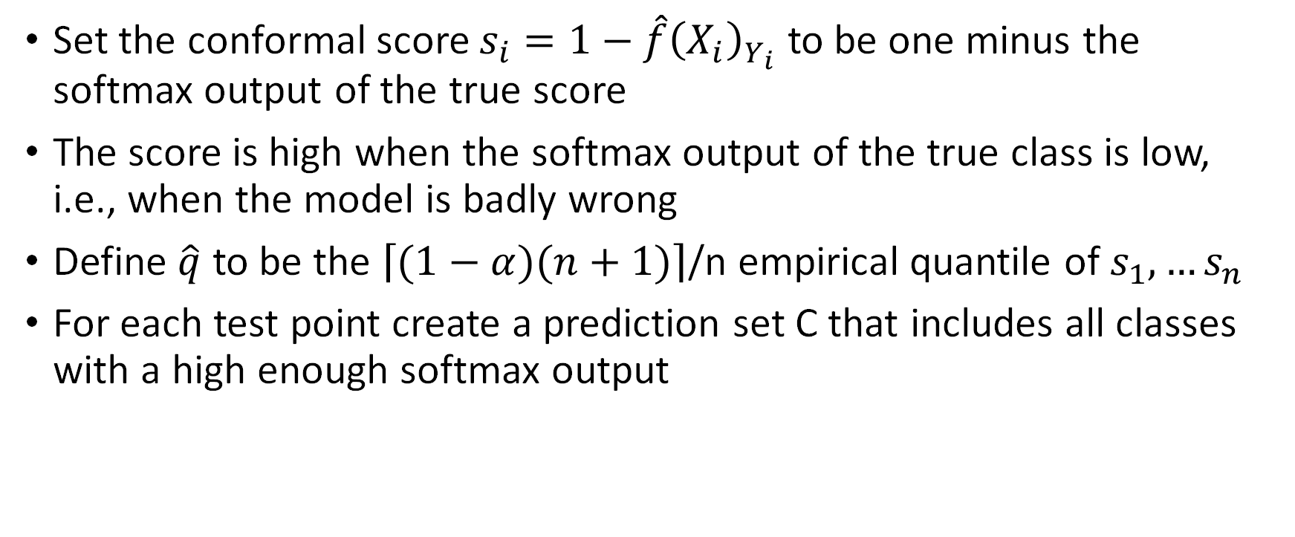
A Simple Conformal Score
Set the conformal score $s_{i}=1−\hat{f}{\left(X_{i}\right)}_{Y_{i}}$ to be one minus the softmax output of the true score
The score is high when the softmax output of the true class is low, i.e., when the model is badly wrong
Define $\hat{q}$ to be the $\left\lceil (1−α)(n+1)\right\rceil$/n empirical quantile of $s_{1},…s_{n}$
For each test point create a prediction set C that includes all classes with a high enough softmax output

Slide 9

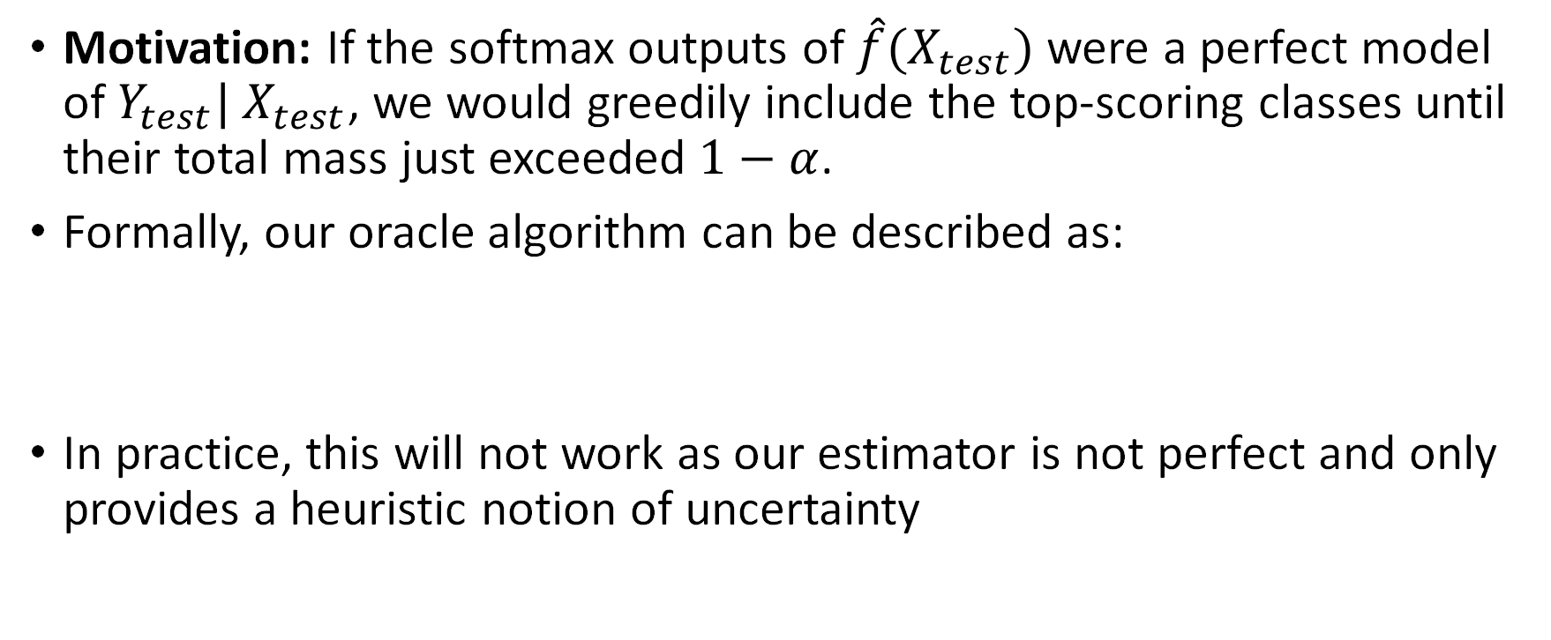
Classification: Adaptive Prediction Sets [1]
Motivation: If the softmax outputs of $\hat{f}(X_{test})$ were a perfect model of $Y_{test}| X_{test}$, we would greedily include the top-scoring classes until their total mass just exceeded $1−α$.
Formally, our oracle algorithm can be described as:
In practice, this will not work as our estimator is not perfect and only provides a heuristic notion of uncertainty

Slide 10

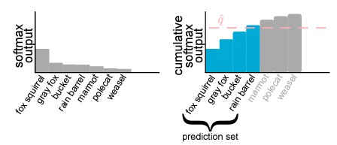

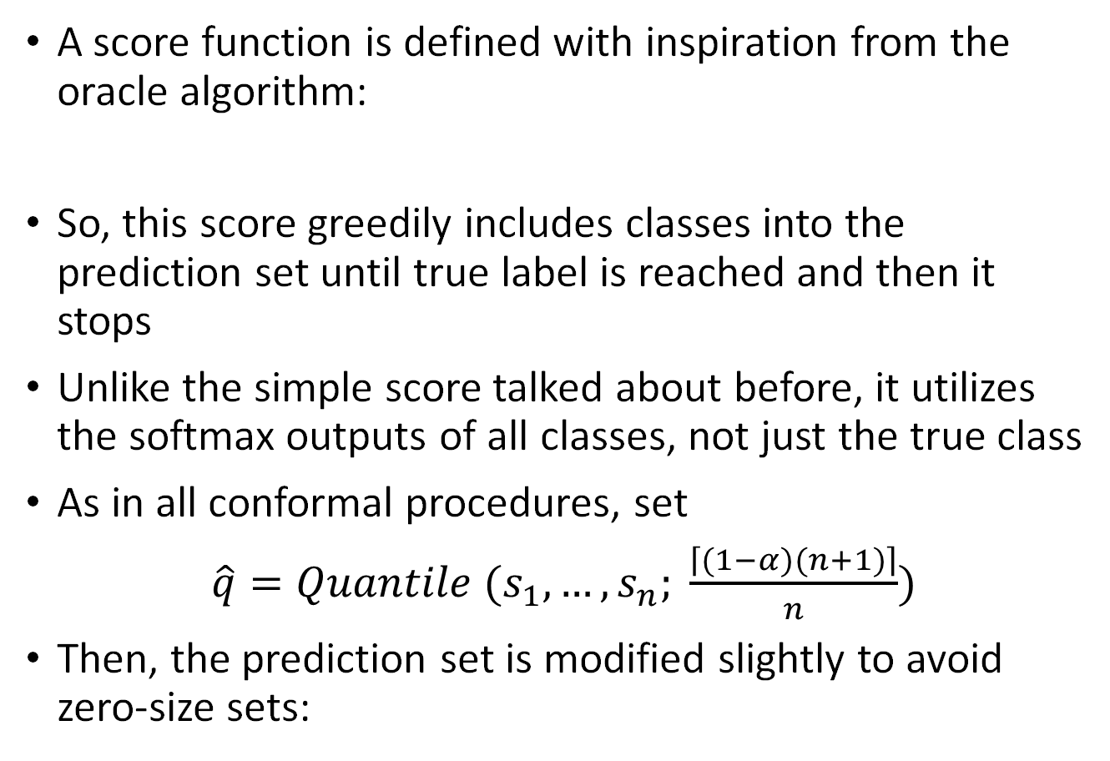
APS continued
A score function is defined with inspiration from the oracle algorithm:
So, this score greedily includes classes into the prediction set until true label is reached and then it stops
Unlike the simple score talked about before, it utilizes the softmax outputs of all classes, not just the true class
As in all conformal procedures, set
$\hat{q}=Quantile (s_{1},…, s_{n}; \frac{\left\lceil (1−α)(n+1)\right\rceil }{n})$
Then, the prediction set is modified slightly to avoid zero-size sets:

Slide 11

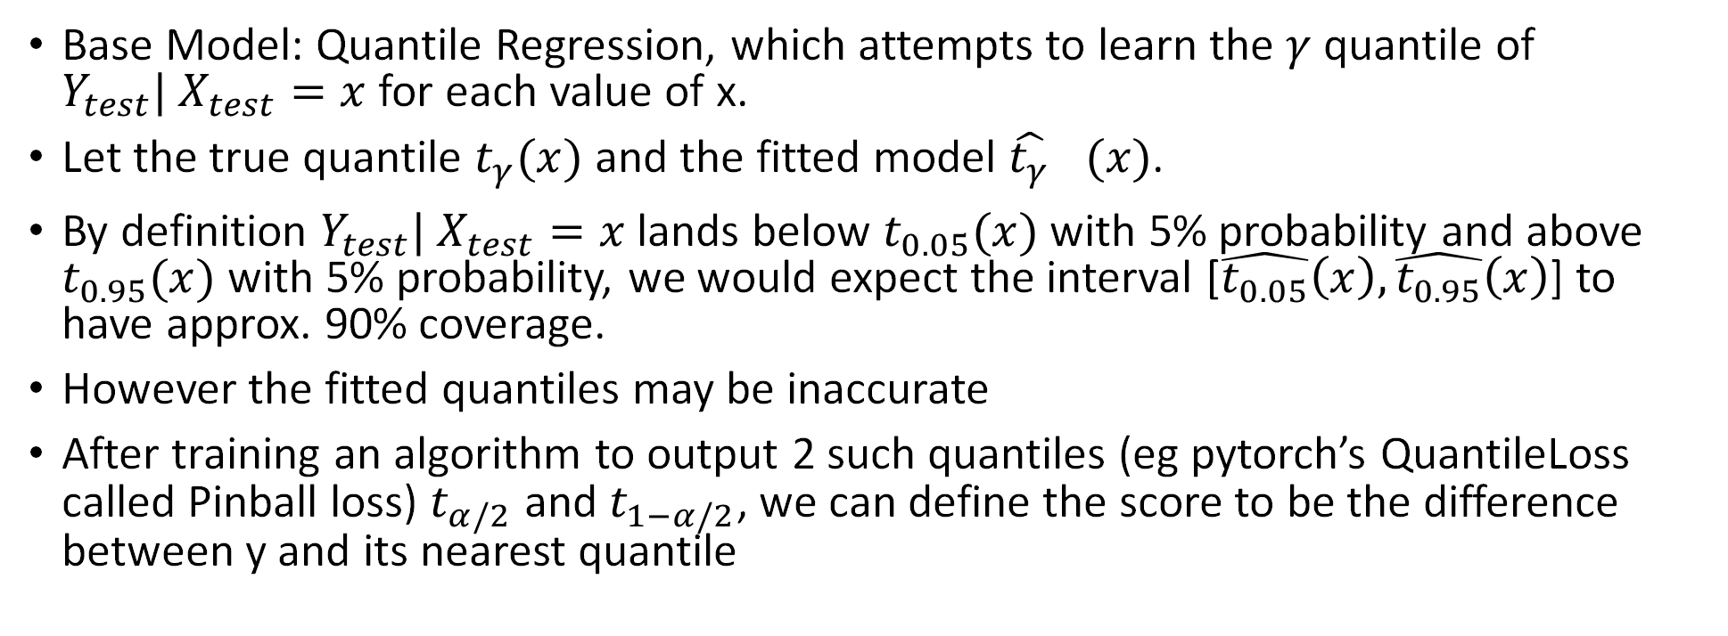
Conformalized Quantile Regression [1]
Base Model: Quantile Regression, which attempts to learn the $γ$ quantile of $Y_{test}| X_{test}=x$ for each value of x.
Let the true quantile $t_{γ}(x)$ and the fitted model ${\hat{t_{γ}}}_{}(x)$.
By definition $Y_{test}| X_{test}=x$ lands below $t_{0.05}(x)$ with 5% probability and above $t_{0.95}(x)$ with 5% probability, we would expect the interval [$\hat{t_{0.05}}\left(x\right),\hat{t_{0.95}}\left(x\right)$] to have approx. 90% coverage.
However the fitted quantiles may be inaccurate
After training an algorithm to output 2 such quantiles (eg pytorch’s QuantileLoss called Pinball loss) $t_{α/2}$ and $t_{1−α/2}$, we can define the score to be the difference between y and its nearest quantile

Slide 12
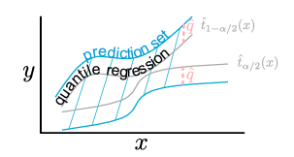

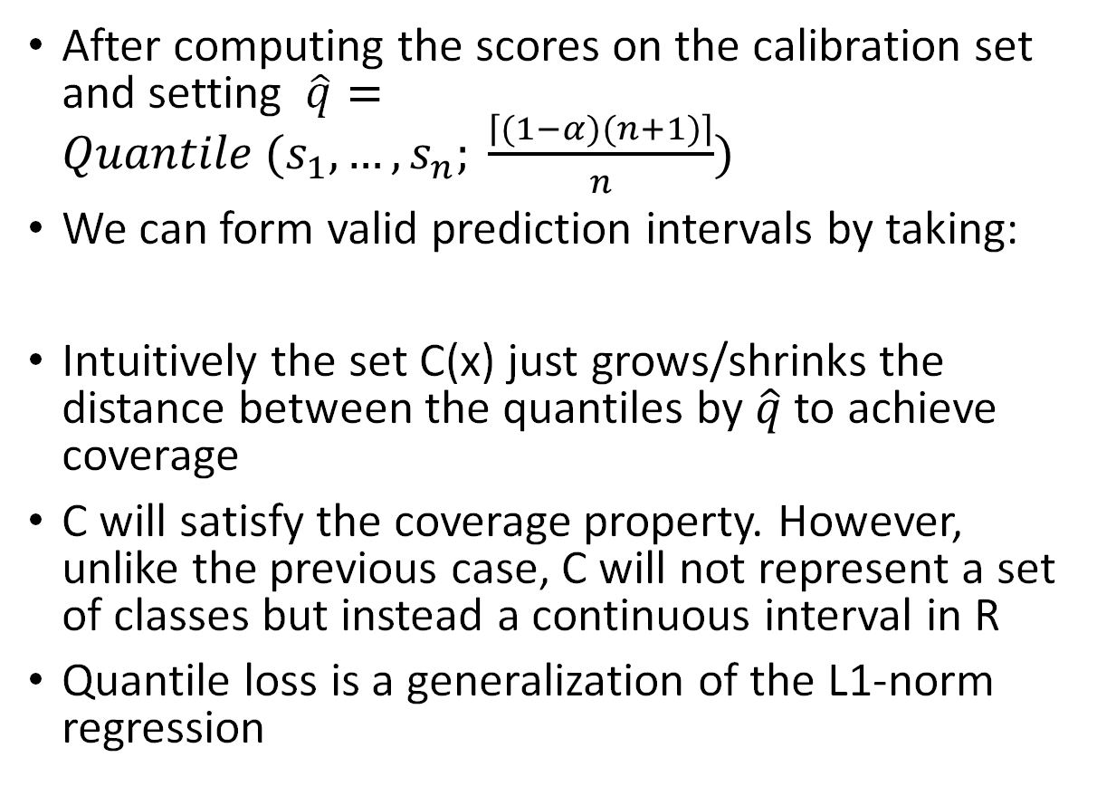
CQR continued
After computing the scores on the calibration set and setting $\hat{q}=Quantile (s_{1},…, s_{n}; \frac{\left\lceil (1−α)(n+1)\right\rceil }{n})$
We can form valid prediction intervals by taking:
Intuitively the set C(x) just grows/shrinks the distance between the quantiles by $\hat{q}$ to achieve coverage
C will satisfy the coverage property. However, unlike the previous case, C will not represent a set of classes but instead a continuous interval in R
Quantile loss is a generalization of the L1-norm regression

Slide 13
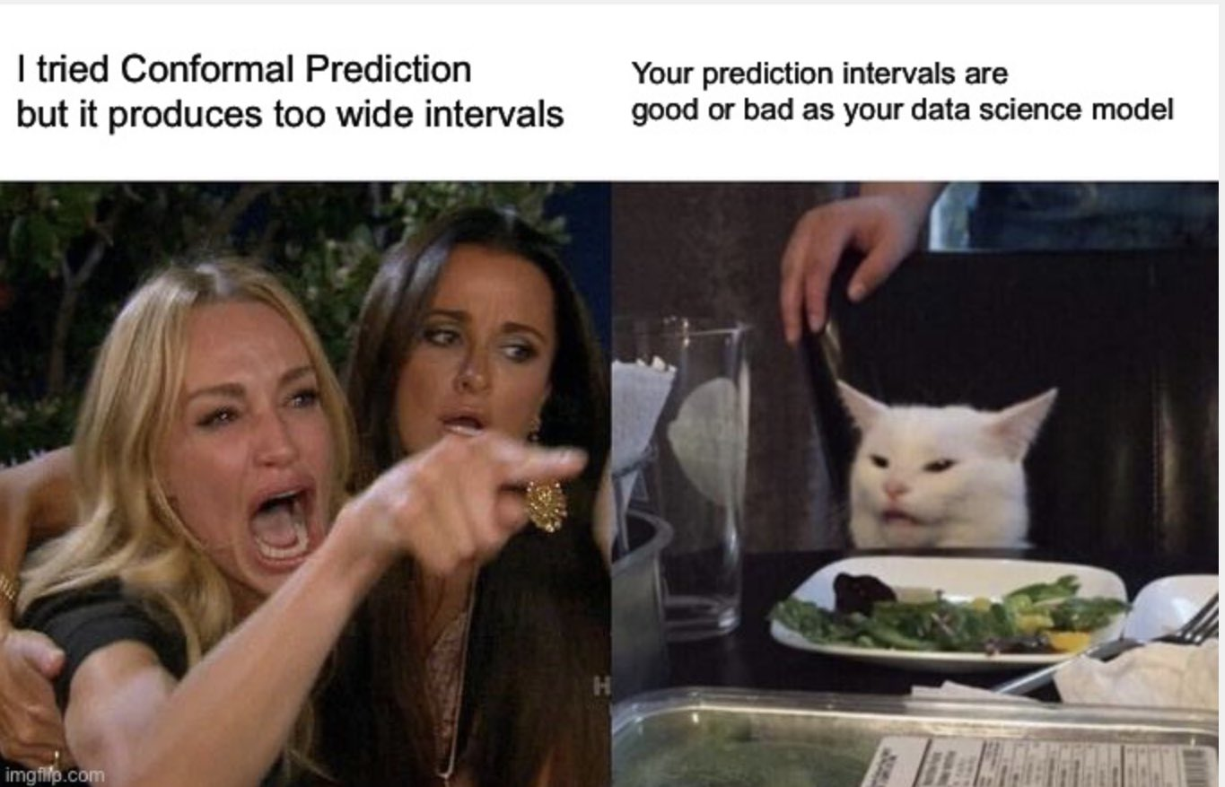
Thanks

